Slide 1

LENDING CLUB CASE STUDY
SUJITH KUMAR

Slide 2
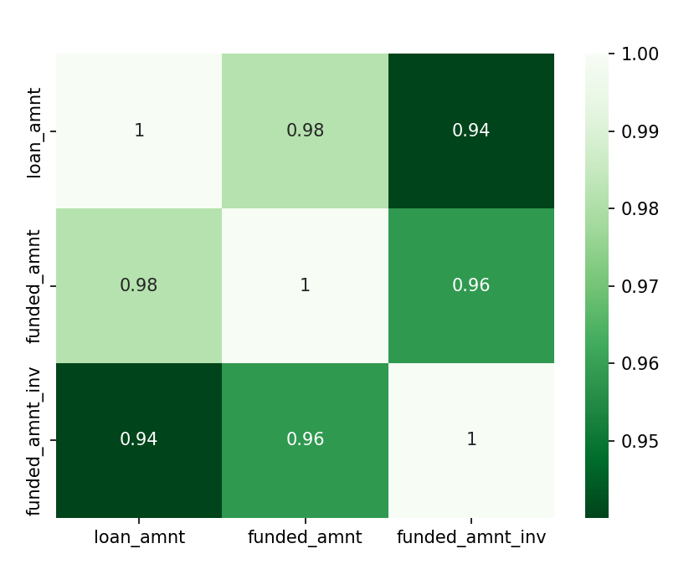
Purpose | data set
Lending Club is a full-spectrum fintech marketplace bank which through technology driven platform offers customers ability to borrow money to meet variety of purposes.
Purpose of this case study is to perform EDA analysis on the data set provided so as to determine the critical attributes which can help determine whether a loan application would be at risk of default or would bring in good business
Initial observations of the data set:
Correlation b/w amount columns
The provided data set has 39,717 rows and 111 columns
There are several columns with NA values
High correlation between loan_amnt, funded_amnt, funded_amnt_inv
Int_rate and revol_util are of type object due to % sign
Emp_Title has over 28K unique values.

Slide 3
Cleansing Data
Type of Cleansing | Description
Drop columns without data | 54 columns from the data set had all values as null
Drop behavioural attributes | Few attributes in the data set are attributes specific to the behaviour of a customer during the tenure of the loan. This data is not available beforehand during the loan application and hence can be disregarded for the analysis. Ex: delinq_2_yrs, earliest_cr_line etc
Drop other attributes which don’t aid in analysis | Attributes such as id, url which are unique and don’t aid in analysis Attributes such as tax_liens which have one unique value (0) and rest null Attributes such as mths_since_last_record where data is mostly null Columns with high correlation – funded_amnt and funded_amnt_inv are highly correlated to loan_amnt and hence can be dropped Other attributes such as zip_code, title which are either masked or have too many variations
Cleanse for Data Type Issue | Character ‘%’ was observed in int_rate and revol_util The 50 rows where revol_util is null was dropped and the % character was removed to correct datatype
Rows excluded from further analysis | Loan_status=Current , are the ongoing loans and would not aid in analysis
Remove Outliers | 397 rows(1%) had annual income which is way above the remaining 99% of the rows There were outliers in the total_acc (number of credit lines in borrowers credit file)

Slide 4
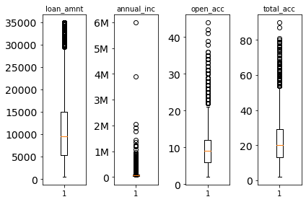
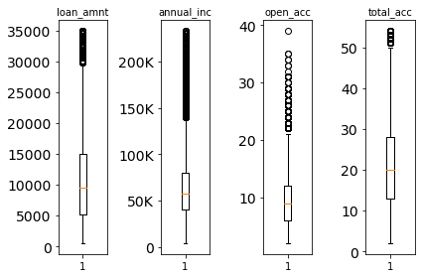
OUTLIERS - ANALYSIS
Before outlier removal
After outlier removal
601 rows in dataset which fall above 99.5 percentile of the loan_amnt ie., 1.56 percent of rows
389 rows in dataset which fall above 99 percentile of the annual_inc ie., 1.01 percent of rows
265 rows in dataset which fall above 99.5 percentile of the open_acc ie., 0.69 percent of rows
206 rows in dataset which fall above 99.5 percentile of the total_acc ie., 0.53 percent of rows
37709 rows remain post exclusion of current ongoing loans and outliers

Slide 5
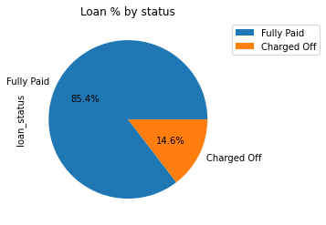
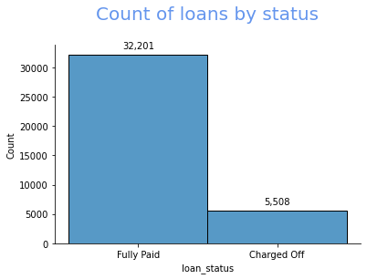
Loan STATUS - analysis

Slide 6
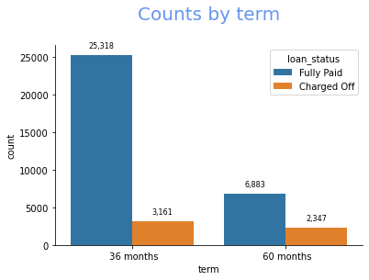
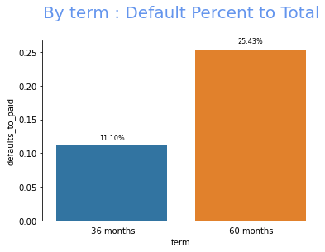
Term – Default vs PAID
Observation: When compared to the total number of loans, loans taken for 60 months have a higher percent of defaults

Slide 7
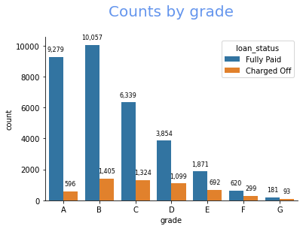
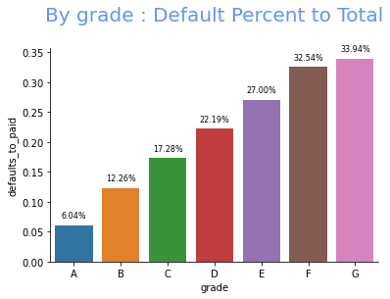
grade – Default vs PAID
Observation:
When compared to the total number of loans, loans classified as grades E, F, G have a higher risk of defaulting
Similar behaviour is observed when plotted against subgrade

Slide 8
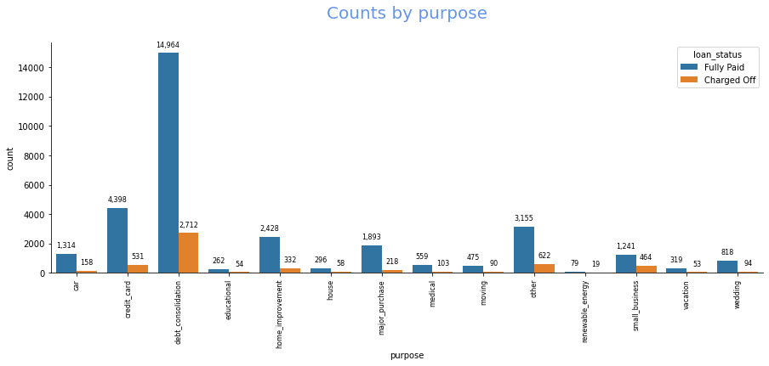
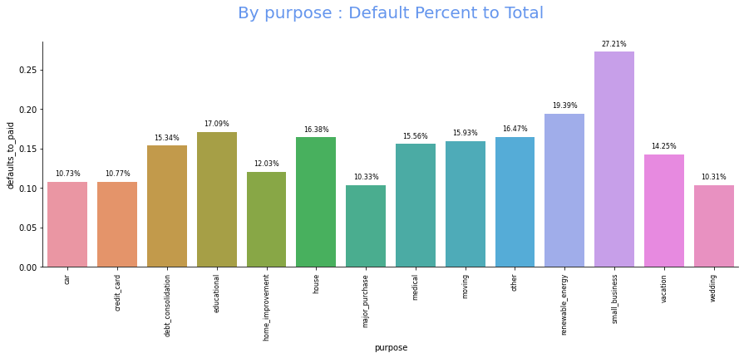
purpose – Default vs PAID
Observation:
Maximum loan is taken for ‘debt consolidation’. While 15% of loans taken for the purpose default, it is also a good business opportunity
Loans taken for small business have a higher percentage of defaulters and should be evaluated

Slide 9
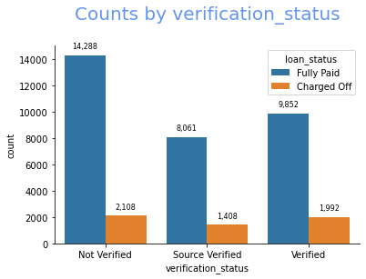
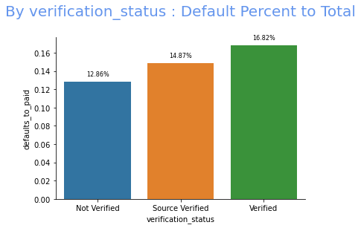
Verification status – Default vs PAID
Observation:
Maximum loans are disbursed without income verification
However, the default percent for loans where income is verified is less when compared with loans where income is verified

Slide 10
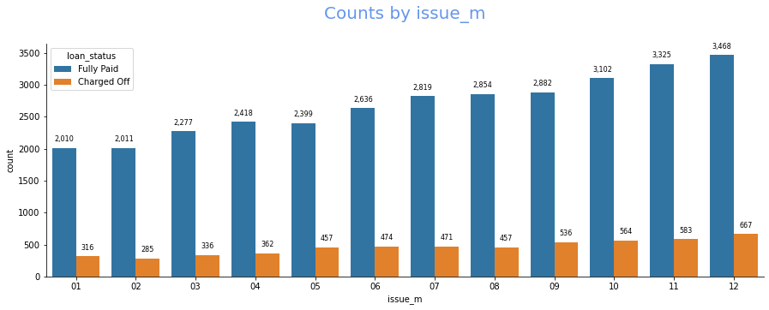
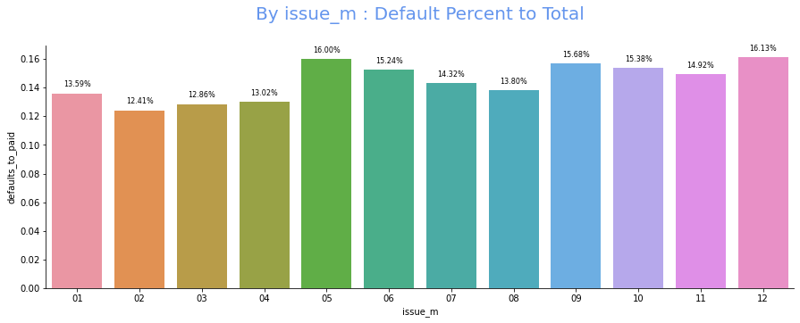
Issued month – Default vs PAID
Observation:
Maximum loans are availed towards the end of the year
Relatively higher defaults are observed post Financial Year close (May) and holiday season(December)

Slide 11
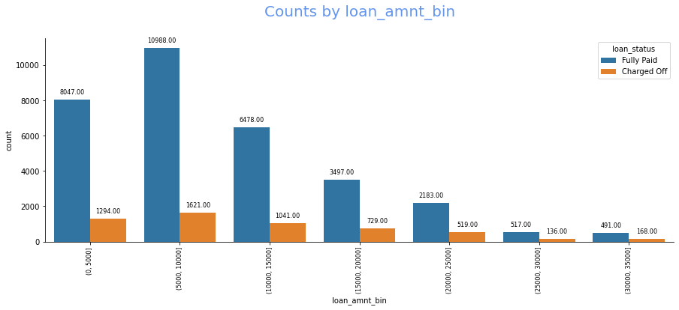
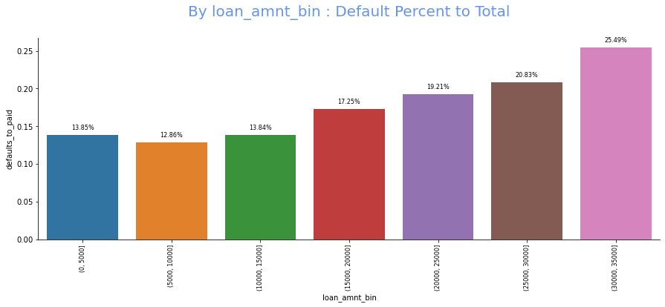
Loan amount – Default vs PAID
Observation:
Maximum loans availed are of low to mid value
Percentage of defaults is higher as the loan amount increases

Slide 12
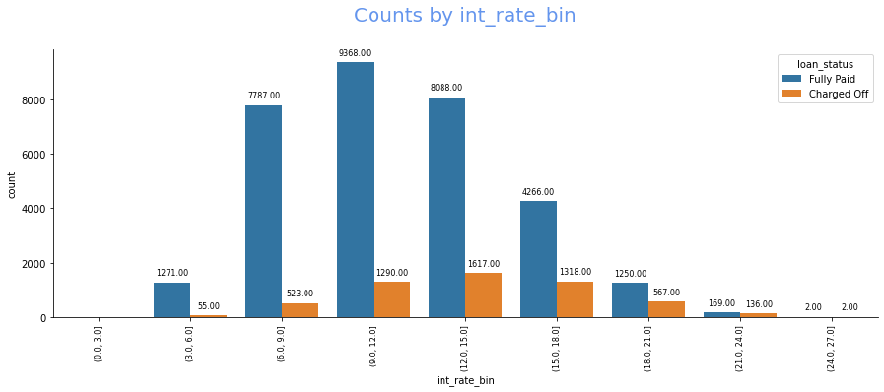
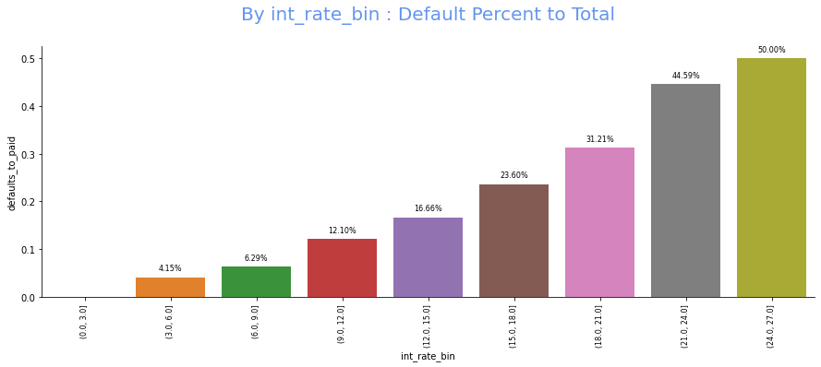
INTEREST RATE – Default vs PAID
Observation:
Low interest rate is driving higher number of loans
As the interest rate increases percentage of defaults also increases

Slide 13
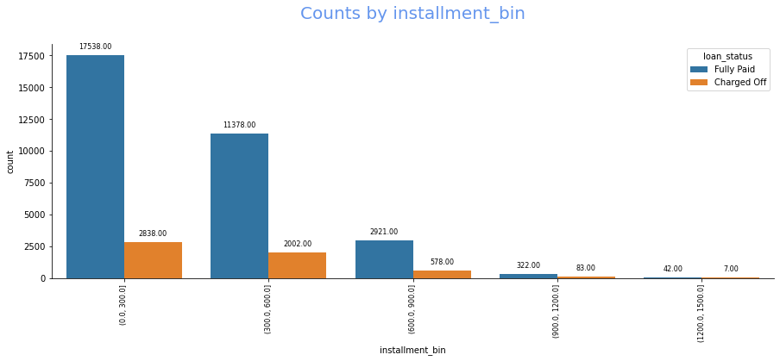
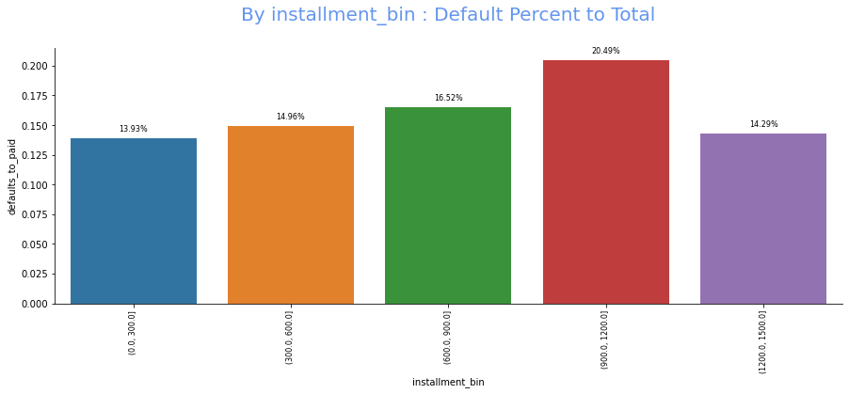
INSTALMENT – Default vs PAID
Observation:
Loans with Instalment below 300$ is most beneficial to business with higher loan disbursement and relatively lower default percentage

Slide 14
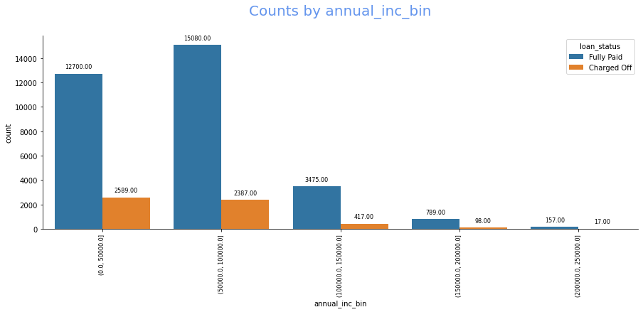
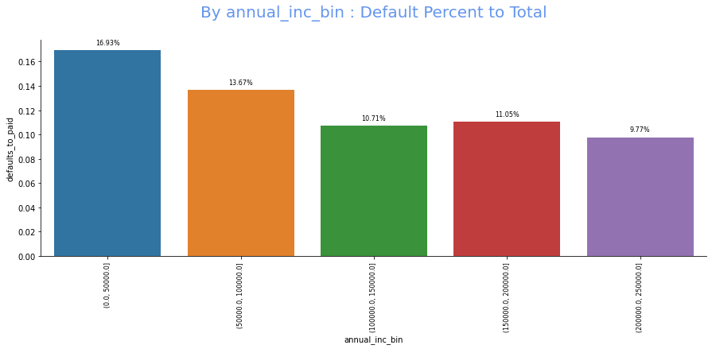
Annual income bin – Default vs PAID
Observation:
Maximum loans are availed by low income groups
Relatively higher defaults are also observed by low income groups

Slide 15
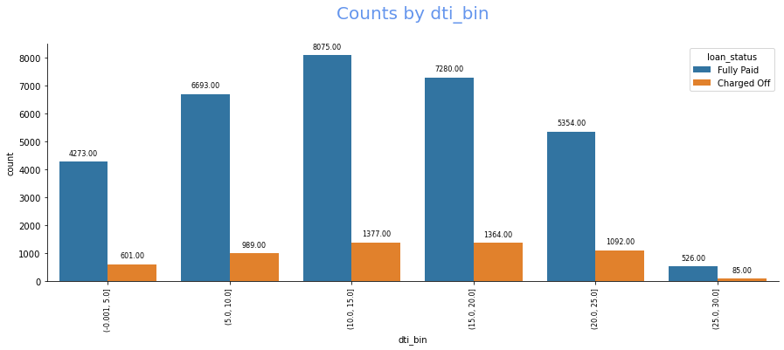
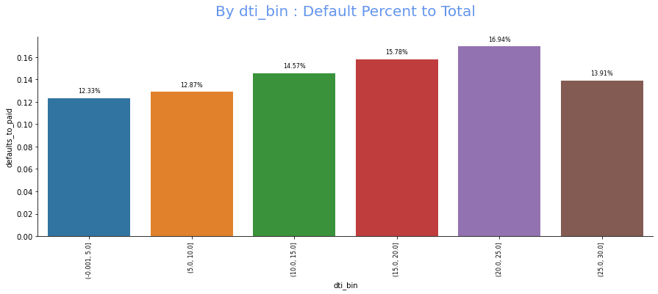
DEBT TO INCOME bin – Default vs PAID
Observation:
Gradual increase in default percent is observed as the Debt to Income ratio increases

Slide 16
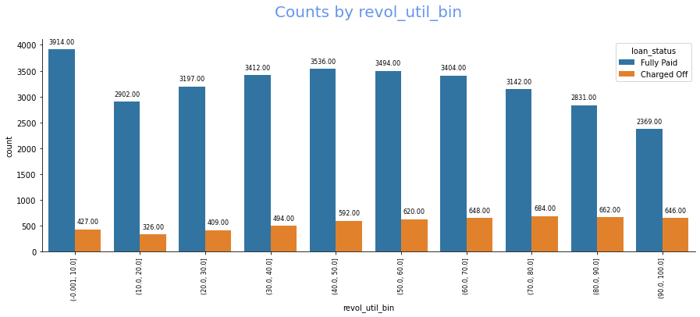
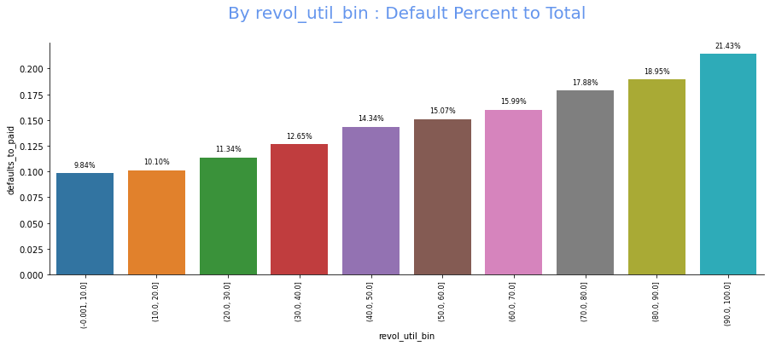
Revolving utilization – Default vs PAID
Observation:
Gradual increase in default percent is observed as the revolving utilization increases

Slide 17
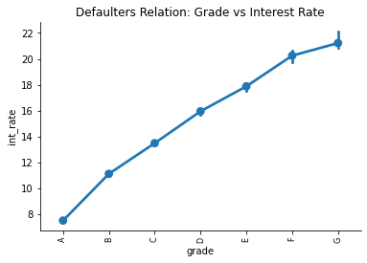
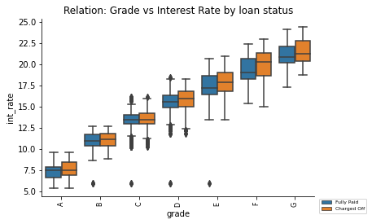
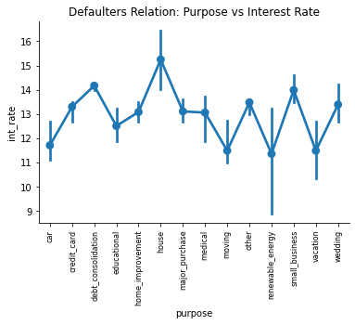
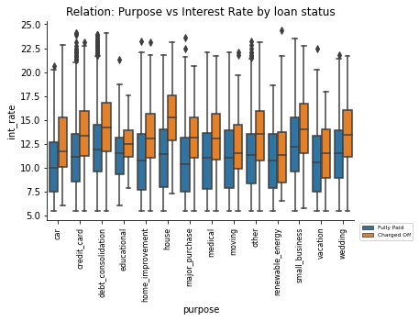
Bivariate analysis – Default vs PAID
Grade vs Interest Rate
Observation:
Interest Rate increases with Grade
Median for default increases with Grade and default rate
Purpose vs Interest Rate
Observation:
Highest interest rate is observed for house, debt consolidation and small business
Median of defaults for these are observed to be high as well

Slide 18
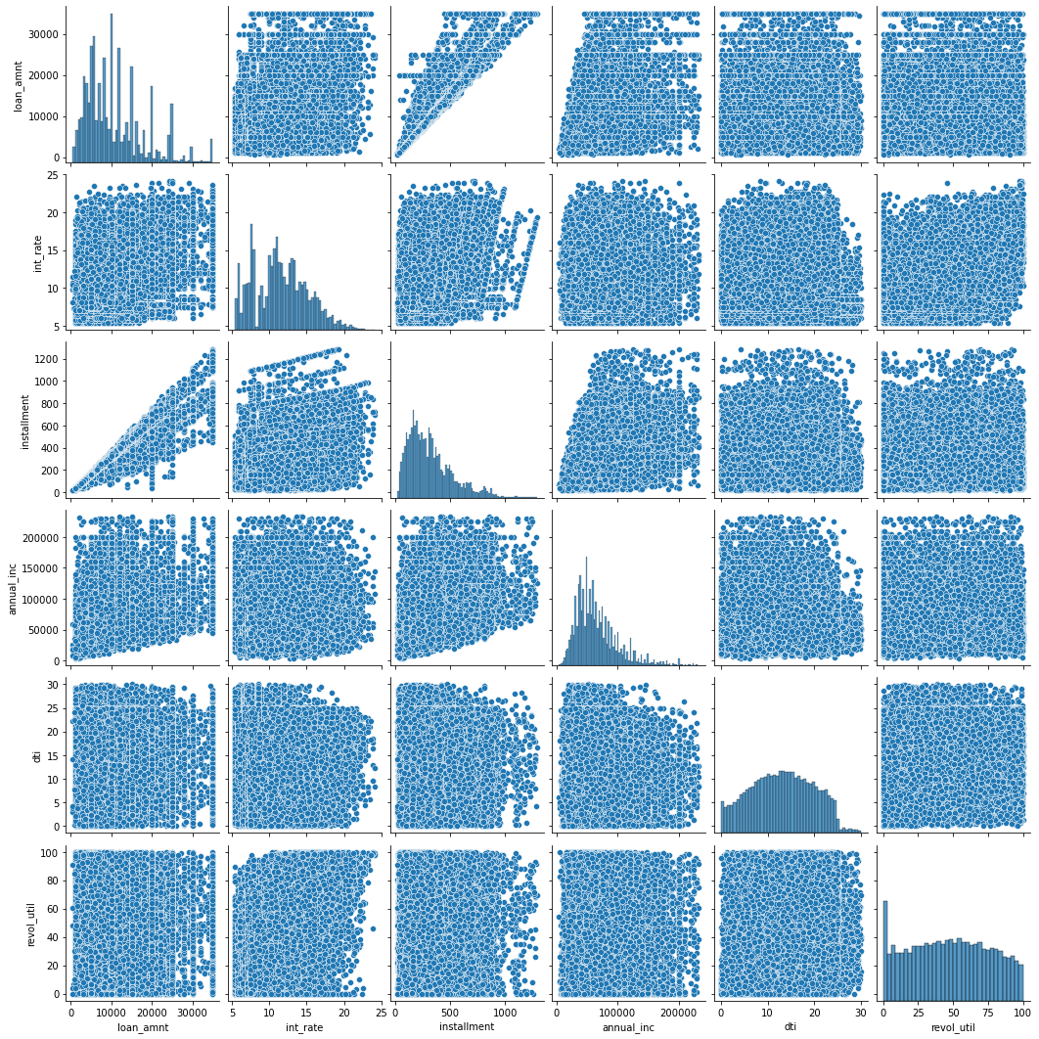
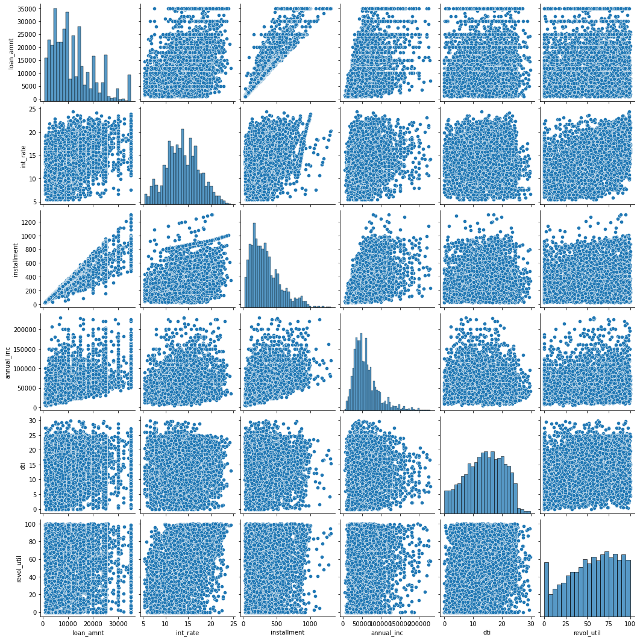
Relation across various attributes (birds view)
Paid Loans
Defaulted Loans

Slide 19
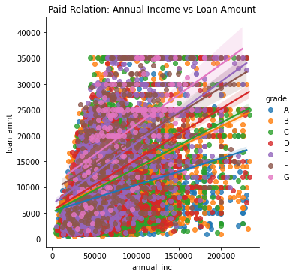
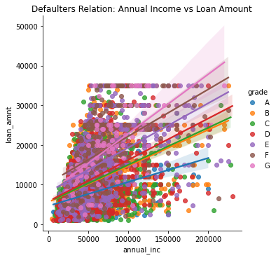
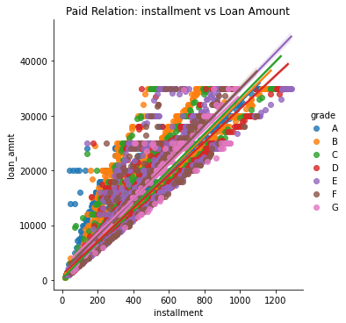
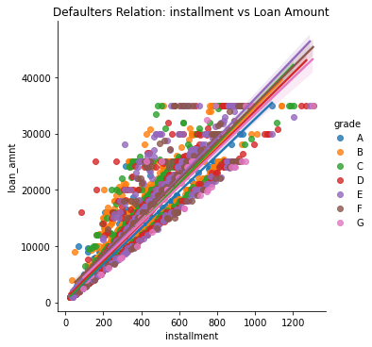
Bivariate analysis – Default vs PAID
Annual Income vs Loan Amount
Observation:
Density of loans availed is high for low-mid range annual income and loan amount
High density of defaults are observed for low-mid range annual income and loan amount
Installment vs Loan Amount
Observation:
As the loan amount increases, installment increases
Density of defaults is high for mid range loan amount and installment

Slide 20
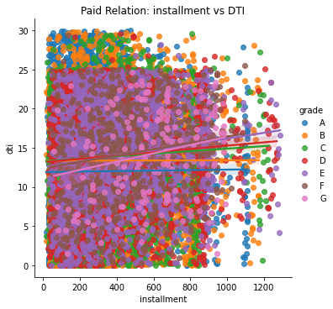
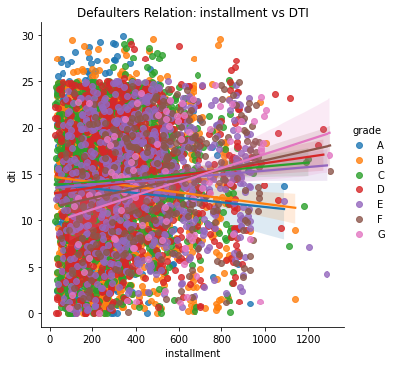
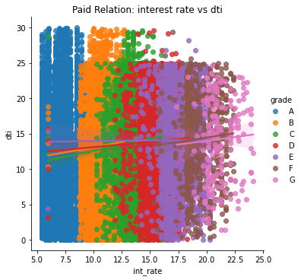
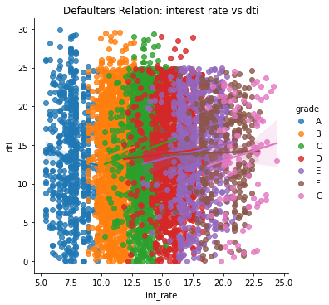
Bivariate analysis – Default vs PAID
Annual Income vs Loan Amount
Observation:
Density of loans availed is high for low-mid range annual income and loan amount
High density of defaults are observed for low-mid range annual income and loan amount
Installment vs Loan Amount
Observation:
As the loan amount increases, installment increases
Density of defaults is high for mid range loan amount and installment

Slide 21
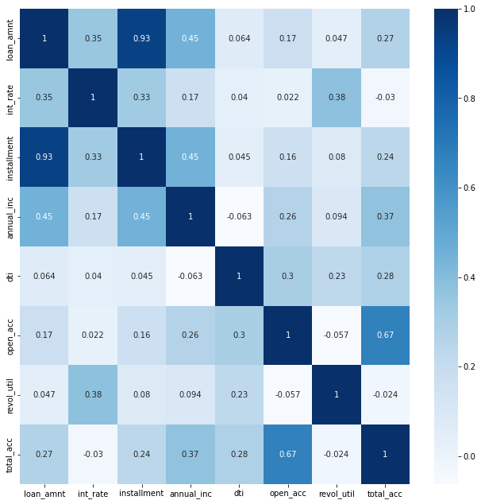
HEAT MAP – DEFAULTED LOANS

Slide 22
OBSERVATIONS, recommendations

